Slide 1


Le Jeu de la Ville
Clément OGÉ
N° 39342
Étude de modèles de villes générées via un automate cellulaire

Slide 2
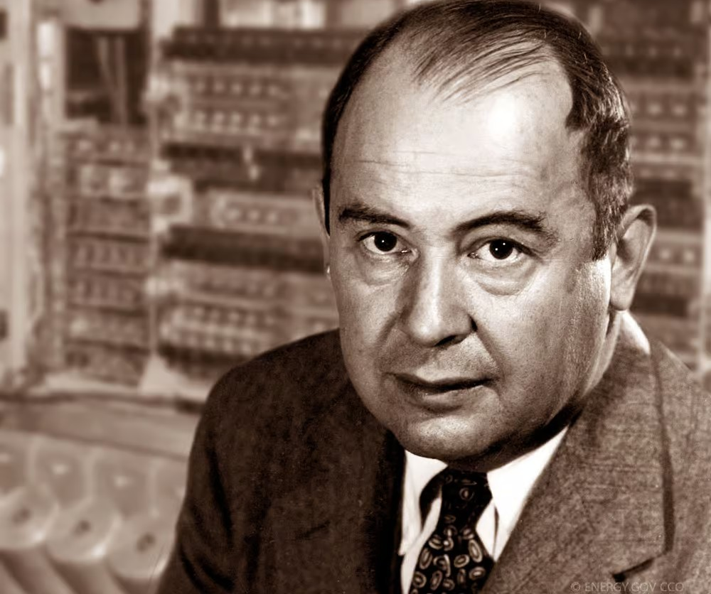
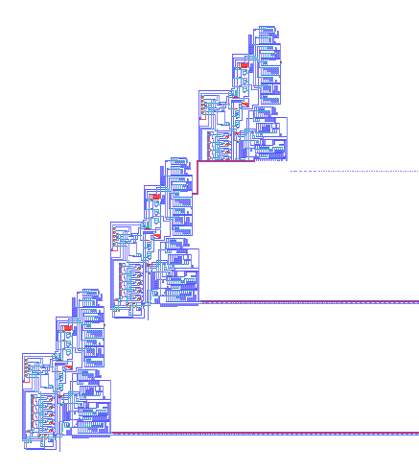
Les automates cellulaires: D’accord, mais pourquoi ?

Slide 3
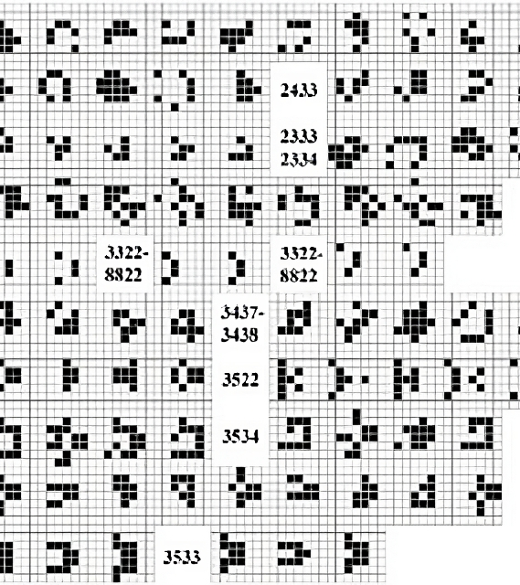

La popularisation des automates cellulaires

Slide 4



Un automate ville-ullaire ..?

Slide 5
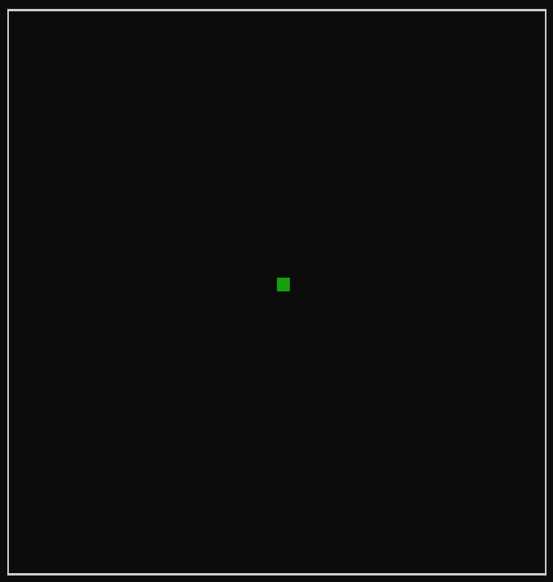
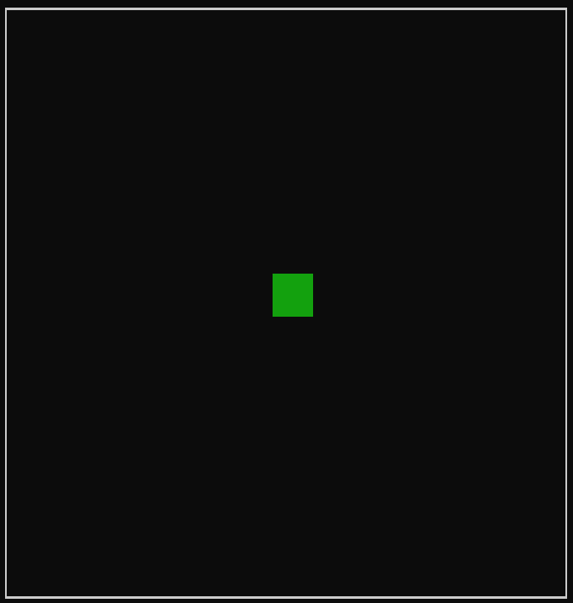
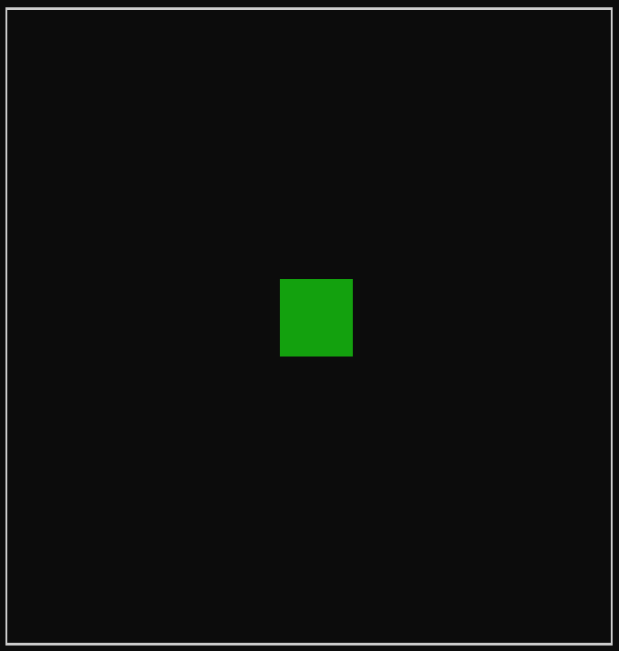
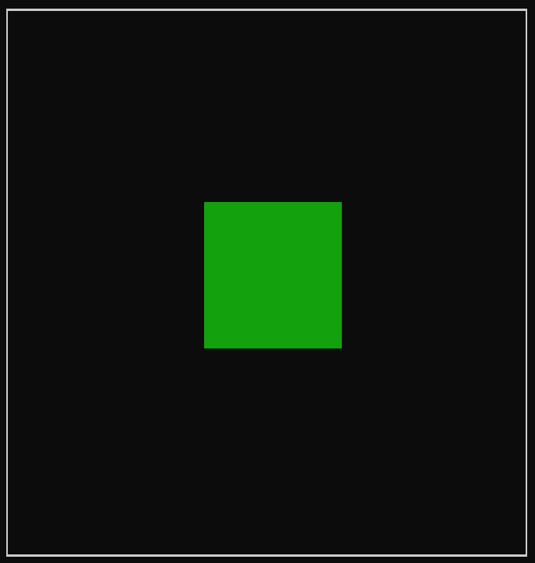
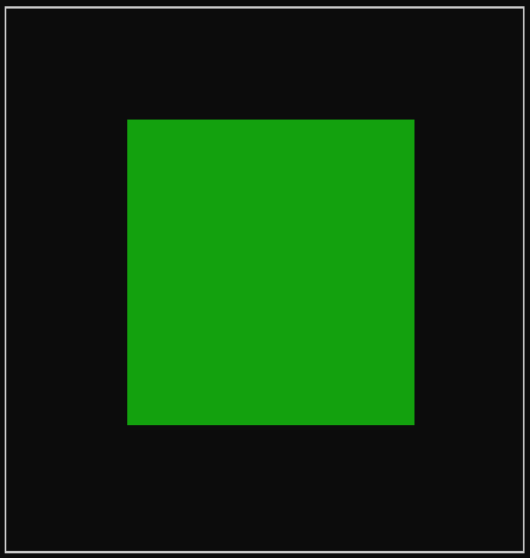
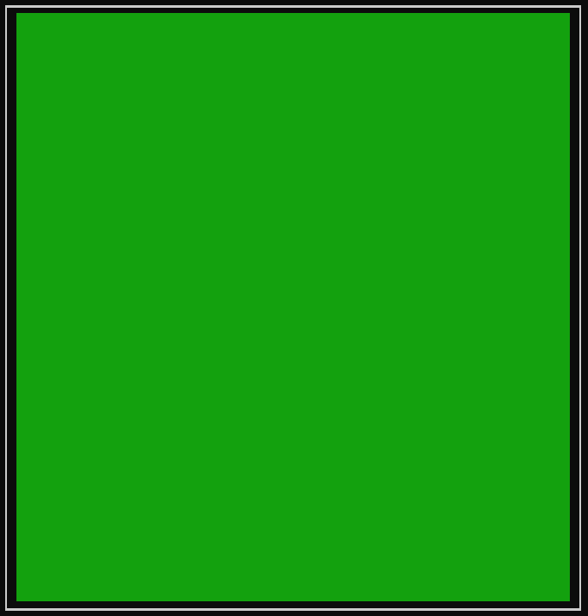
L’évolution

Slide 6
L’évolution

Slide 7
L’évolution

Slide 8
Résultats
TODO: add screenshots

Slide 9


Limites et potentiel

Slide 10


Un modèle viable ?

Slide 11
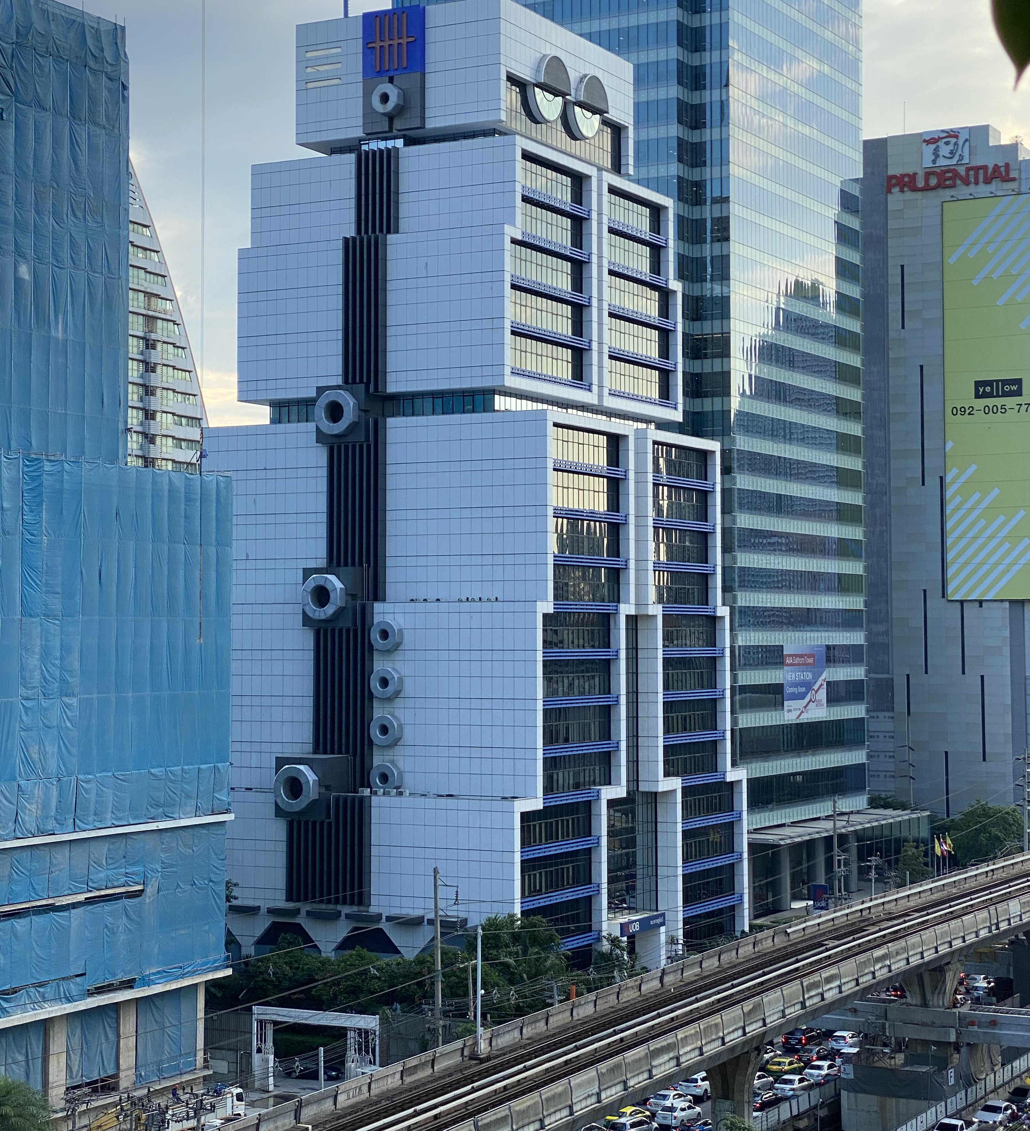

Thanks u 4 wachting

Slide 12
#include <stdio.h>
#include <stdlib.h>
#include <time.h>
/// Generator configuration
#define HEIGHT 41
#define LENGTH 96
#define NEIGHBOURS_DISTANCE 6
#define CELL_TYPE_COUNT 5
#define PRINT_INTERVAL 100 // in ms
const int CELL_COUNT = HEIGHT * LENGTH;
const int NEIGHBOURS_COUNT = (2*NEIGHBOURS_DISTANCE + 1)
* (2*NEIGHBOURS_DISTANCE + 1) -1;
/// Functions
int min(int a, int b) { return a > b ? b : a; }
int max(int a, int b) { return a > b ? a : b; }
double min_d(double a, double b) { return a > b ? b : a; }
double max_d(double a, double b) { return a > b ? a : b; }
void clearStdout() {
#ifdef _WIN32
system("cls");
#elif _WIN64
system("cls");
#elif __unix__
system("clear");
#endif
}
void wait(int ms) {
struct timespec ts;
ts.tv_sec = ms / 1000;
ts.tv_nsec = (ms % 1000) * 1000000;
nanosleep(&ts, NULL);
}
void printGrid(int *grid){
char *colors[CELL_TYPE_COUNT] = {
"", // none
"\e[0;32m", // green
"\e[0;34m", // blue
"\e[0;33m", // orange
"\e[0;37m", // white
};
printf("\n┏━");
for (int i = 0; i < LENGTH; i++)
printf("━━");
printf("━┓\n");
for (int i = 0; i < HEIGHT; i++) {
printf("┃ ");
for (int j = 0; j < LENGTH; j++) {
printf("%s%s",
j == 0 || grid[i * LENGTH + j] != grid[i * LENGTH + j - 1]
? colors[grid[i * LENGTH + j]] : "",
grid[i * LENGTH + j] ? "██" : " "
);
}
printf("\e[0m ┃\n");
}
printf("┗━");
for (int i = 0; i < LENGTH; i++)
printf("━━");
printf("━┛\n");
}

Slide 13
int **findNeighbours(int *grid, int k) {
const int kx = k % LENGTH, ky = k / LENGTH;
int *total_neighbours = malloc(sizeof(int *) * NEIGHBOURS_DISTANCE);
int **res = malloc(sizeof(int *) * NEIGHBOURS_DISTANCE);
for (int i = NEIGHBOURS_DISTANCE; i--;) {
total_neighbours[i] = 0;
res[i] = malloc(sizeof(int) * CELL_TYPE_COUNT);
for (int j = CELL_TYPE_COUNT; j--; res[i][j] = 0);
}
for (int x = max(0, kx - NEIGHBOURS_DISTANCE); x <= min(LENGTH - 1, kx + NEIGHBOURS_DISTANCE); x++) {
for (int y = max(0, ky - NEIGHBOURS_DISTANCE); y <= min(HEIGHT - 1, ky + NEIGHBOURS_DISTANCE); y++) {
if (y == ky && x == kx) continue;
int d = max(abs(x - kx), abs(y - ky));
for (int i = d; i <= NEIGHBOURS_DISTANCE; i++) {
res[i - 1][grid[y * LENGTH + x]]++;
total_neighbours[d]++;
}
}
}
for (int i = 0; i < NEIGHBOURS_DISTANCE; i++)
res[i][0] += NEIGHBOURS_COUNT - total_neighbours[i];
free(total_neighbours);
return res;
}
void printStats(int grid[CELL_COUNT]) {
// Init table
int count[CELL_TYPE_COUNT];
for (int i = CELL_TYPE_COUNT; i--; count[i] = 0);
// Count cells in grid
for (int i = CELL_COUNT; i--; count[grid[i]]++);
printf("\e[0;32mHouses\e[0m: %d (%2.1lf%%) - \e[0;34mShops\e[0m: %d (%2.1lf%%) - \e[0;33mWorkplaces\e[0m: %d (%2.1lf%%) - \e[0;37mParks\e[0m: %d (%2.1lf%%)\n",
count[1], 100 * ((double)count[1] / CELL_COUNT),
count[2], 100 * ((double)count[2] / CELL_COUNT),
count[3], 100 * ((double)count[3] / CELL_COUNT),
count[4], 100 * ((double)count[4] / CELL_COUNT));
}
void nextGeneration(int *grid) {
int *res = malloc(sizeof(int) * CELL_COUNT);
for (int i = 0; i < CELL_COUNT; i++)
res[i] = grid[i];
for (int i = 0; i < CELL_COUNT; i++) {
int **neighbours = findNeighbours(grid, i);
double probs[CELL_TYPE_COUNT];
for (int i = 0; i < CELL_TYPE_COUNT; i++) probs[i] = 0;
// ...

Slide 14
// Void to
if (grid[i] == 0) {
// House
probs[1] = 0.000015 + 0.01 * (neighbours[0][1] >= 1) * (1 + neighbours[0][1] / 1.5) * max(1, 3 * neighbours[0][2]) * max(1, 6 * neighbours[0][4]);
// Shop
probs[2] = 0.000020 * (neighbours[3][2] == 0) * neighbours[0][1] + 0.01 * (neighbours[0][3] <= 1 && neighbours[0][2] >= 1 && neighbours[5][2] <= 16);
// Work
probs[3] = 0.000025 * (neighbours[3][3] == 0 && neighbours[2][2] <= 3) * neighbours[0][1] + 0.01 * (neighbours[0][2] <= 1 && neighbours[0][3] >= 1 && neighbours[4][3] <= 7);
// Park
probs[4] = 0.001 * (neighbours[4][1] >= 60 && neighbours[5][4] == 0);
}
// House to
else if (grid[i] == 1) {
// Void
probs[0] = 0;
// Shop
probs[2] = 0.000020 * (neighbours[3][2] == 0) * neighbours[0][1] + 0.01 * (neighbours[0][3] <= 1 && neighbours[0][2] >= 1 && neighbours[5][2] <= 16);
// Work
probs[3] = 0.000025 * (neighbours[3][3] == 0 && neighbours[2][2] <= 3) * neighbours[0][1] + 0.01 * (neighbours[0][2] <= 1 && neighbours[0][3] >= 1 && neighbours[4][3] <= 7);
// Park
probs[4] = 0.001 * (neighbours[3][1] >= 30 && neighbours[1][4] <= 5 && neighbours[5][4] <= 5) * (10 * neighbours[0][4]) * max(neighbours[0][1], 1);
}
// Shop to
else if (grid[i] == 2) {
// Void
probs[0] = 0;
// House
probs[1] = 0.01 * (neighbours[0][2] < 2);
// Work
probs[3] = 0;
// Park
probs[4] = 0;
} // Workplace to
else if (grid[i] == 3) {
// Void
probs[0] = 0;
// House
probs[1] = 0.01 * (neighbours[1][3] < 2);
// Shop
probs[2] = 0;
// Park
probs[4] = 0;
}

Slide 15
/// Rand choice
// Init tables
double prob_sum = 0;
for (int j = 0; j < CELL_TYPE_COUNT; j++)
prob_sum += j != i ? probs[j] : 0;
probs[grid[i]] = 1 - prob_sum;
double sc[CELL_TYPE_COUNT] = {probs[0], 0, 0, 0, 0};
for (int j = 1; j < CELL_TYPE_COUNT; j++)
sc[j] = sc[j - 1] + probs[j];
// Wheighed choice
int choice = 0;
double rand_double = ((double)rand() / RAND_MAX);
while(choice < CELL_TYPE_COUNT - 1 && sc[choice] < rand_double)
choice++;
if (choice != grid[i])
res[i] = choice;
// Free stuff
for (int i = NEIGHBOURS_DISTANCE; i--; free(neighbours[i]));
free(neighbours);
}
// Copy res to grid
for (int i = CELL_COUNT; i--; grid[i] = res[i]);
free(res);
}
// Park to
else if (grid[i] == 4) {
// Void
probs[0] = 0;
// House
probs[1] = 0.01 * (neighbours[0][1] < 2 || neighbours[1][1] < 8);
// Shop
probs[2] = 0;
// Work
probs[3] = 0;
// Park
// /
}

Slide 16
int main() {
const long int start_time = time(NULL);
srand(start_time);
int *grid = malloc(sizeof(int) * CELL_COUNT);
for (int i = 0; i < CELL_COUNT; i++)
grid[i] = 0;
// Print first grid
printGrid(grid);
printStats(grid);
wait(PRINT_INTERVAL);
// Main loop
for (int64_t gens = 1; ;) {
// Start timer
struct timespec start, end;
clock_gettime(CLOCK_MONOTONIC_RAW, &start);
// Compute next grid
nextGeneration(grid);
// Clear previously displayed grid
fflush(stdout);
clearStdout();
// Print next grid
printGrid(grid);
printStats(grid);
// End timer
clock_gettime(CLOCK_MONOTONIC_RAW, &end);
int time_spent = (end.tv_sec - start.tv_sec) * 1000000 + (end.tv_nsec - start.tv_nsec) / 1000;
// Print debug stats
printf("\e[0;39mGeneration #%ld - Elapsed time: %lds - FPS: %2.0f - Rendered in: %2.3fms\e[0m\n",
++gens, time(NULL) - start_time, (double)gens / (time(NULL) - start_time), (double)time_spent / 1000);
wait(max(PRINT_INTERVAL - time_spent / 1000, 0));
}
return 0;
}

